Slide 1
Lecture 15
Random Variables and Discrete Probability Distributions

Slide 2
Review
1 What is a sample space?
The collection of all possible outcomes of a random trial.
2 What is the law of large numbers?
As the number of trials grows, the relative frequency of A gets closer and closer to P(A).
3 What are disjoint (mutually exclusive) events?
Events with no outcomes in common, so they cannot happen together: A ∩ B = ∅

Slide 3
Two more rules
general addition rule
P(A ∪ B) = P(A) + P(B) − P(A ∩ B): subtract the overlap so it is not counted twice
multiplication rule
if A and B are independent (one occurring does not change the probability of the other): P(A ∩ B) = P(A) · P(B)
disjoint ≠ independent
disjoint events cannot happen together, so knowing one happened tells you the other did not

Slide 4
Example: one die
Roll a fair six-sided die once.
S = {1, 2, 3, 4, 5, 6}, each outcome has probability 1/6
(a) What is P(not a six)?
(b) What is P(1 ∪ 6)?
(c) What is P(even ∪ greater than 3)?
(a) 1 − 1/6 = 5/6 (rule 4)
(b) 1/6 + 1/6 = 1/3 (rule 3: a 1 and a 6 are disjoint)
(c) 3/6 + 3/6 − 2/6 = 4/6 (the 4 and the 6 are in both)

Slide 5
Example: two dice
Roll a fair die twice. The two rolls are independent.
P(six) = 1/6 on each roll
(a) What is P(six on both rolls)?
(b) What is P(at least one six)?
(a) (1/6)(1/6) = 1/36 (multiplication rule)
(b) 1 − P(no sixes) = 1 − (5/6)(5/6) = 11/36 ≈ 0.31

Slide 6
Data: student heights
A survey of 379 college students recorded each student's height and gender.
X = the height of a student, in inches
HEIGHT | GENDER
56 | Female
57 | Female
58 | Female
60 | Female
60 | Female
… | …
n = 379 students (the file lists the women first, then the men, each sorted by height)

Slide 7
Example: unions and intersections
Pick one of the 379 students at random. F = female, T = at least 70 in.
 | At least 70 in | Under 70 in | Total
Female | 19 | 243 | 262
Male | 87 | 30 | 117
Total | 106 | 273 | 379
(a) What is P(F ∩ T)?
(b) What is P(F ∪ T)?
(a) 19 / 379 ≈ 0.05
(b) 262/379 + 106/379 − 19/379 = 349/379 ≈ 0.92

Slide 8
Are F and T independent?
Pick one of the 379 students at random. F = female, T = at least 70 in.
 | At least 70 in | Under 70 in | Total
Female | 19 | 243 | 262
Male | 87 | 30 | 117
Total | 106 | 273 | 379
Does knowing a student is female change the chance they are at least 70 in?
Yes: 106/379 ≈ 28% of all students, but only 19/262 ≈ 7% of the women
Not independent: P(F) · P(T) ≈ 0.69 · 0.28 ≈ 0.19, but P(F ∩ T) ≈ 0.05

Slide 9
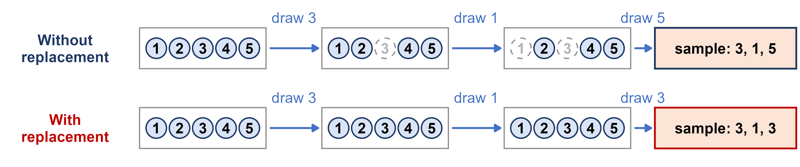
With or without replacement?
Week 4: drawing a sample of 3 balls from a bag of 5, two ways.
Are the draws independent?
With replacement: yes. The bag is the same on every draw, so P(A ∩ B) = P(A) · P(B)
Without replacement: no. Each draw changes what is left, so the next probability depends on the last draw

Slide 10
Example: drawing from an urn
An urn holds 3 red, 4 blue and 3 yellow balls. Draw 2 balls without replacement.
10 balls in all: 3 red, 4 blue, 3 yellow
(a) What is P(both red)?
(b) What is P(no red balls)?
(c) What is P(both the same color)?
(a) (3/10)(2/9) = 6/90 ≈ 0.067
(b) (7/10)(6/9) = 42/90 ≈ 0.467
(c) (3/10)(2/9) + (4/10)(3/9) + (3/10)(2/9) = 24/90 ≈ 0.267

Slide 11
Example: drawing two aces
A standard deck has 52 cards, 4 of them aces. Draw two cards.
P(ace on the first draw) = 4/52
(a) What is P(two aces) if the first card is put back (with replacement)?
(b) What is P(two aces) if it is not put back (without replacement)?
(a) (4/52)(4/52) = 1/169 ≈ 0.0059: the draws are independent
(b) (4/52)(3/51) = 1/221 ≈ 0.0045: only 3 aces are left among 51 cards

Slide 12
Random variables
random variable
the outcome of a random trial recorded as a number, written with a capital letter such as X
discrete
its possible values can be listed: the number of heads in 3 tosses, X = 0, 1, 2, 3
continuous
it can take any value in an interval: a student's height

Slide 13
Example: three coin tosses
Toss a fair coin 3 times: 2 × 2 × 2 = 8 equally likely outcomes.
X = the number of heads
(a) List the sample space S.
(b) How many outcomes give each value of X?
S = {HHH, HHT, HTH, THH, HTT, THT, TTH, TTT}
X = 0: 1 X = 1: 3 X = 2: 3 X = 3: 1 (out of 8)

Slide 14
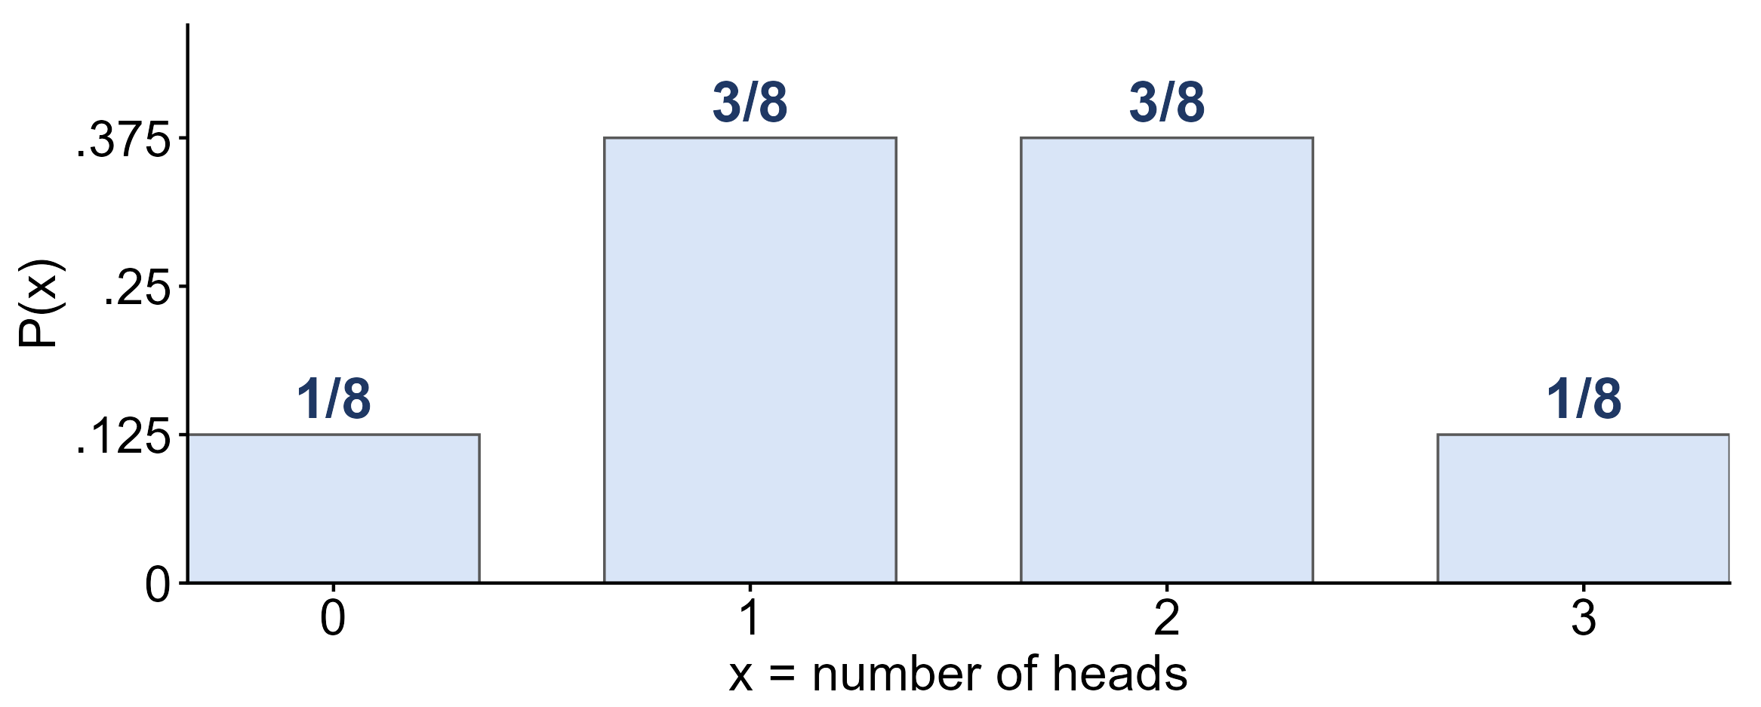
Discrete probability distributions
probability distribution
a function that assigns a probability to each possible value of X; each is between 0 and 1, and they add to 1
1 + 3 + 3 + 1 = 8, so the probabilities add to 8/8 = 1

Slide 15
Example: using a distribution
X = the number of heads in 3 tosses of a fair coin.
P(0) = 1/8 P(1) = 3/8 P(2) = 3/8 P(3) = 1/8
(a) What is P(X ≥ 2)?
(b) What is P(X ≤ 1)?
(c) What is P(1 ≤ X ≤ 2)?
(a) 3/8 + 1/8 = 4/8
(b) 1 − P(X ≥ 2) = 1 − 4/8 = 4/8
(c) 3/8 + 3/8 = 6/8

Slide 16
The mean of a random variable
expected value μ
the long-run average of X: μ = Σ x · P(x)
variance σ²
σ² = Σ (x − μ)² · P(x), and the standard deviation is σ = √σ²
three coin tosses
μ = 0(1/8) + 1(3/8) + 2(3/8) + 3(1/8) = 1.5 heads

Slide 17
Example: grade points
A STAT 251 exam grade on the 4-point scale, for a student chosen at random:
x | 0 | 1 | 2 | 3 | 4
grade | F | D | C | B | A
P(x) | 0.05 | 0.10 | 0.30 | 0.25 | 0.30
(a) What is P(better than a C)?
(b) What is the mean grade, μ?
(a) P(X = 3) + P(X = 4) = 0.25 + 0.30 = 0.55
(b) μ = 0(0.05) + 1(0.10) + 2(0.30) + 3(0.25) + 4(0.30) = 2.65

Slide 18
Bernoulli trials
Bernoulli trial
one trial with two outcomes: success (X = 1) with probability p, failure (X = 0) with probability 1 − p
X ~ Bernoulli(p)
its single parameter p is the probability of success
mean and variance
μ = p and σ² = p(1 − p)

Slide 19
Example: guessing one question
You guess on a multiple-choice question with 4 options, one of them correct.
X = 1 if the guess is right, X = 0 if not; p = 1/4 = 0.25
(a) What is P(X = 0)?
(b) What are μ and σ²?
(a) 1 − 0.25 = 0.75
(b) μ = 0.25, σ² = 0.25 × 0.75 = 0.1875

Slide 20
The binomial setting
a fixed number of trials n
the trial is repeated a set number of times, decided in advance
two outcomes, the same p
each trial is a success or a failure, with the same probability of success p every time
independent trials
the outcome of one trial does not change the probability of success on any other

Slide 21
The binomial distribution
X ~ Binom(n, p)
X = the number of successes in n independent trials, each with probability of success p
P(X = k)
n! / (k!(n − k)!) · p^{k} · (1 − p)^{n−k}: the first factor counts the ways to arrange k successes
mean and variance
μ = np and σ² = np(1 − p)

Slide 22
Example: three tosses again
Friday: X = the number of heads in 3 tosses of a fair coin, counted from the 8 outcomes.
X ~ Binom(n = 3, p = 0.5)
(a) Use the formula to find P(X = 2).
(b) What does 3! / (2! 1!) count?
(a) 3!/(2! 1!) · 0.5² · 0.5¹ = 3 × 1/8 = 3/8: the same answer as counting
(b) the 3 orders with 2 heads: HHT, HTH, THH

Slide 23
Example: guessing a whole quiz
You guess on all 10 questions of a 4-option multiple-choice quiz.
X ~ Binom(n = 10, p = 0.25)
(a) What is P(X = 3)?
(b) What is P(X = 0)?
(c) What are μ and σ?
(a) 10!/(3! 7!) · 0.25³ · 0.75⁷ = 120 × 0.0156 × 0.1335 ≈ 0.250
(b) 0.75¹⁰ ≈ 0.056
(c) μ = 10 × 0.25 = 2.5, σ = √(10 × 0.25 × 0.75) ≈ 1.37

Slide 24
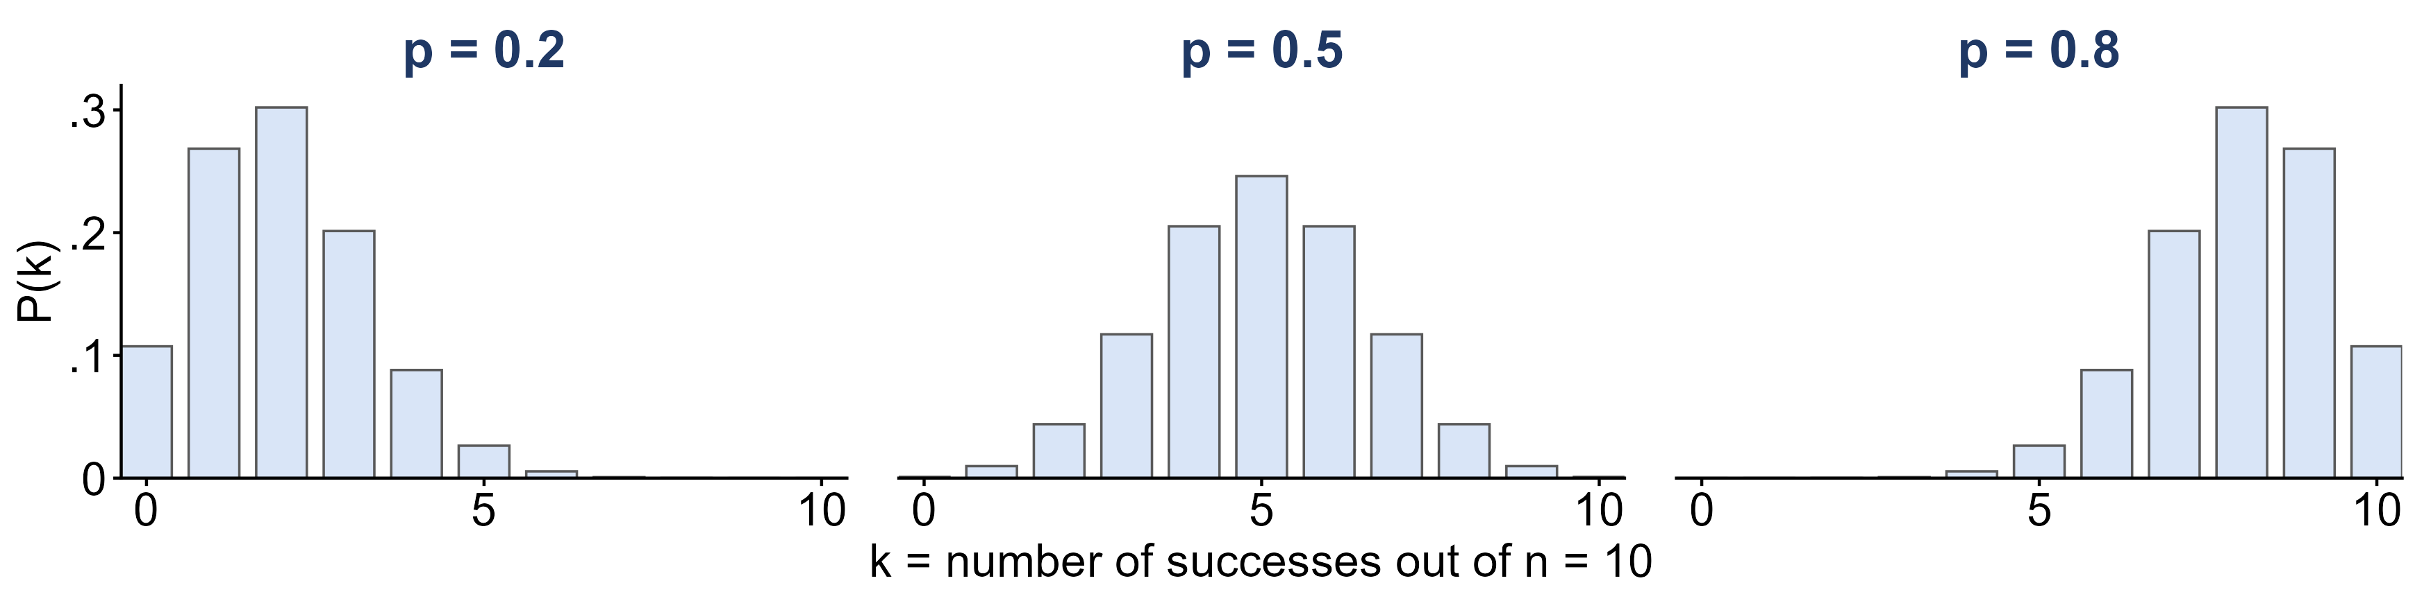
The shape of a binomial distribution
X ~ Binom(n = 10, p) for three values of p.
What does p do to the shape?
p = 0.5: symmetric. p < 0.5: skewed right. p > 0.5: skewed left.
The center sits at μ = np: 2, 5 and 8

Slide 25
Example: free throws
Stephen Curry has made 4,236 of the 4,645 free throws he has attempted in the NBA.
p = 4,236 / 4,645 ≈ 0.912; he shoots n = 10; X = free throws made
(a) What is P(he makes all 10)?
(b) What is P(he misses at least one)?
(c) How many does he make, on average?
(a) 0.912¹⁰ ≈ 0.40
(b) 1 − 0.40 = 0.60
(c) μ = np = 10 × 0.912 ≈ 9.1

Slide 26
Is it binomial?
For each X, check the three conditions: fixed n, the same p, independent trials.
(a) X = the number of heads in 20 flips of a coin
(b) X = the number of aces in a 5-card hand
(c) X = the number of rolls of a die until the first six
(a) Yes: n = 20, p = 0.5, and the flips are independent
(b) No: the cards are dealt without replacement, so the draws are not independent
(c) No: the number of trials n is not fixed

Slide 27
The Poisson distribution
X ~ Poisson(λ)
X = the number of events in a fixed interval of time or space, when events occur independently at an average rate λ
P(X = k)
λ^{k} e^{−λ} / k!, k = 0, 1, 2, … (e ≈ 2.718)
mean and variance
μ = λ and σ² = λ

Slide 28
Example: World Cup goals
The 2022 FIFA World Cup had 172 goals in 64 matches.
λ = 172 / 64 ≈ 2.69 goals per match; X = goals in one match
(a) What is P(X = 0)?
(b) How many of the 64 matches does the model expect to end 0–0? (There were 7.)
(c) What is λ for one 45-minute half, and P(no goals in a half)?
(a) e^{−2.69} ≈ 0.068
(b) 64 × 0.068 ≈ 4.4: close, but a model is never a perfect fit
(c) λ = 2.69 / 2 ≈ 1.34, P(X = 0) = e^{−1.34} ≈ 0.26

Slide 29
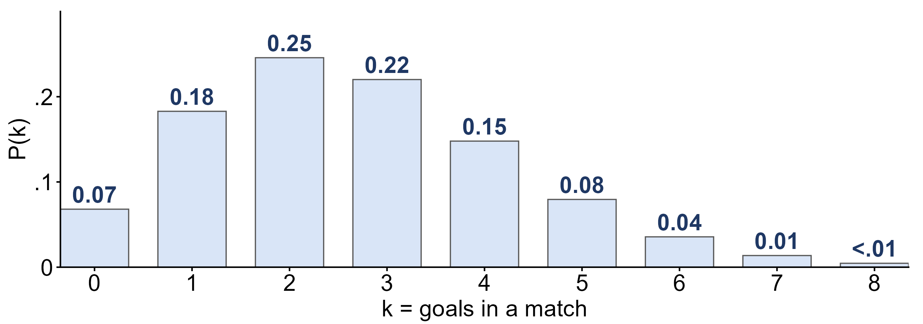
Goals per match: the Poisson model
X ~ Poisson(λ = 2.69): the probability of each number of goals in a match.
Which number of goals is most likely? Is the distribution symmetric?
Two goals (0.25), then three (0.22); skewed right: X cannot go below 0 but has no upper limit

Slide 30
What you should know: discrete distributions
probability rules
P(A′) = 1 − P(A); P(A ∪ B) = P(A) + P(B) − P(A ∩ B); independent: P(A ∩ B) = P(A) P(B)
random variables
a discrete distribution lists each value of X with its probability, adding to 1; μ = Σ x P(x)
binomial
successes in n independent trials with the same p: μ = np, σ² = np(1 − p); Bernoulli is n = 1
Poisson
events in a fixed interval at an average rate λ: μ = σ² = λ

